Slide 1
Workshop 7
Chew Guo Jie Jason (A0176614B)
Cho Zin Tun (A0098996W)
Peh Yingqi Amelia (A0071186E)
Toh Pei Xuan (A0000584R)

Slide 2
Part a
Objective Function: z (profit) => sum of value at state s at market state i
objective.. z =e= sum((s,i),v(s,i))
Value of from state s to state sp at market state i, where the change in state is <= 2: value of state s at market state i - sum of (values at state sp * probability of state sp * discounted factor per month)
stateValue(s,i,sp)$(abs(ord(sp)-ord(s))le lag)..v(s,i)-b*sum(j,pr(i,j)*v(sp,j))=g=decision_profit(s,i,sp);
stateValue(s0,normal,s0): v(s0,normal) -0.8*0.995*v(s0,normal) –0.1*0.995*v(s0,disrupted) 0.1*0.995*v(s0,very_disrupted)

Slide 3
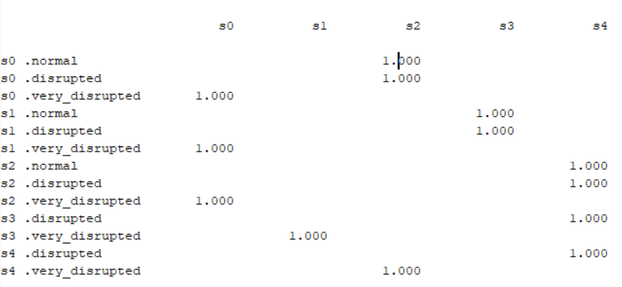
Part b i
If my inventory level is 0 (s0) the market is normal, the action is to buy 200kbl to have an inventory of s2

Slide 4
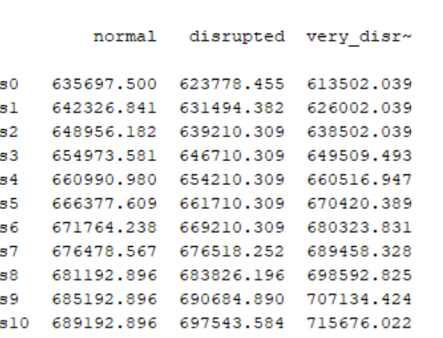
Part b ii
At state inventory = 0, and market is normal,
present value of the profit in state is $635697

Slide 5
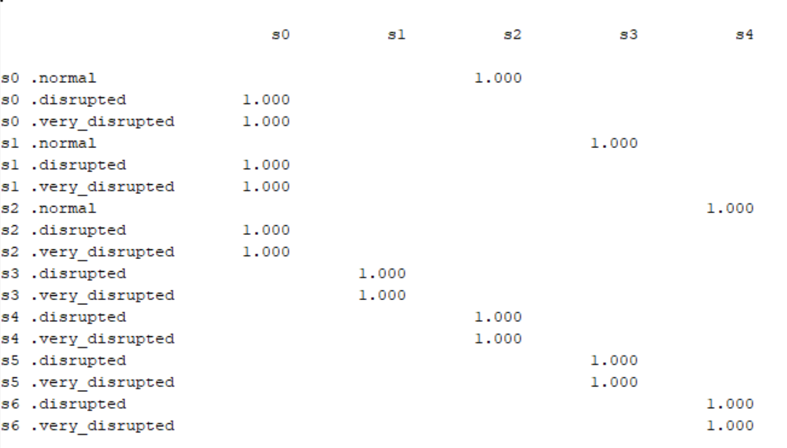
Part c i
The policy changes. When the market is disrupted,
At h = 0.995 the optimal policy is to buy 1 unit
At h = 0.9 the optimal policy is to sell up to 2 units

Slide 6
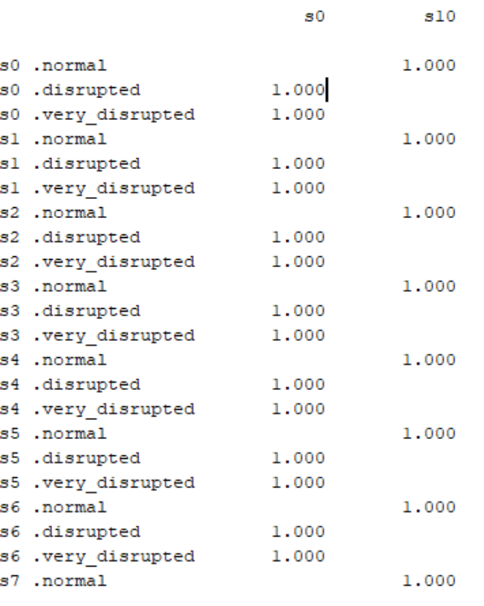
Part c ii
When there is no limit to sell/buy amount,
When market is normal, buy maximum
When market is disrupted or very disrupted, sell maximum

Slide 7
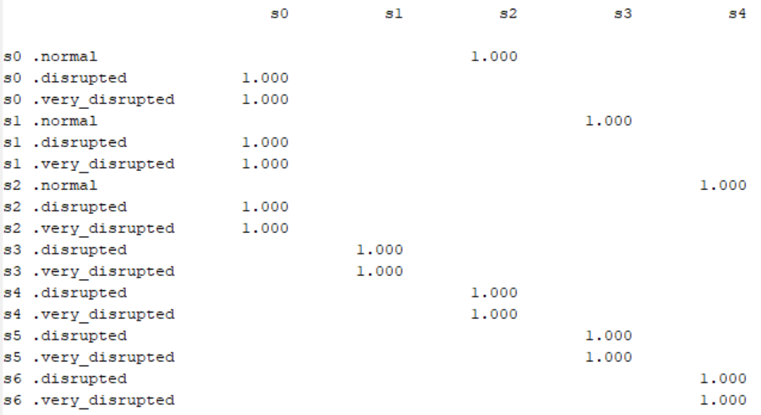
Part c iii
The policy changes. When the market is disrupted,
For the old matrix the optimal policy is to buy 1 unit
For the new matrix the optimal policy is to sell up to 2 units

Slide 8
Part d
No restriction to the amount of oil traded is the most important to spectator’s success

